Slide 1



OUR
6 DOF robot manipulator Forward & Inverse Kinematics
Presentation
by PHLOUCH SOKCHEA
PHLOUCH SOKCHEA e20201275

Slide 2
forward
Kinematics
PHLOUCH Sokchea e20201275

Slide 3
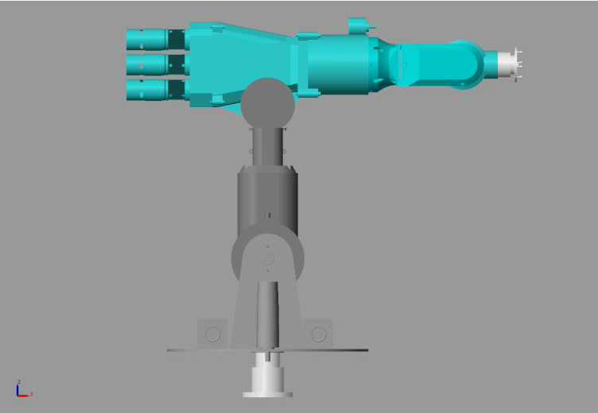
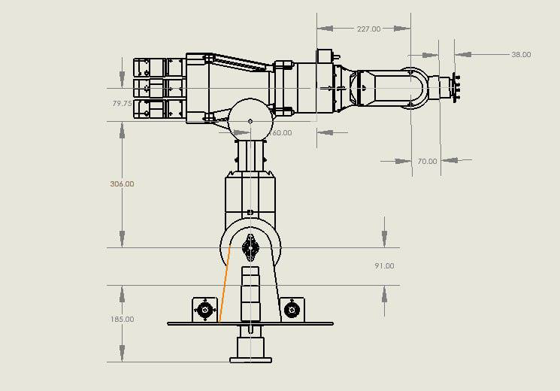
I. Robot Model
1
PHLOUCH Sokchea e20201275

Slide 4
I. Robot Model
Link 4p = 227mm
Link 5 = 70mm
Link 6 = 38mm
Link 4 = 160mm
l4
l4p
l5
l6
l3
Link 3 = 79.75mm
l2
Link 44p = 160+227mm
Link 2 = 306mm
Link 56 = 70+38mm
l1
Link 1 = 276mm
2
PHLOUCH Sokchea e20201275

Slide 5
DH Table
DH parameters
Link | Joint | a (i-1) | alpha (i-1) | d (i) | Theta (i)
0 – 1 | 1 | 0 | 0 | link1 | Theta1
1 – 2 | 2 | 0 | -90 | 0 | Theta2 - 90
2 – 3 | 3 | link2 | 0 | 0 | Theta3
3 – 4 | 4 | link3 | -90 | 0 | Theta4
4 – 4p | 4p | 0 | 0 | Link44p | 0
4p – 5 | 5 | 0 | 90 | 0 | Theta5
5 - 6 | 6 | 0 | -90 | 0 | Theta6
6 - 7 | 7 | 0 | 0 | link56 | 0
3
PHLOUCH Sokchea e20201275

Slide 6
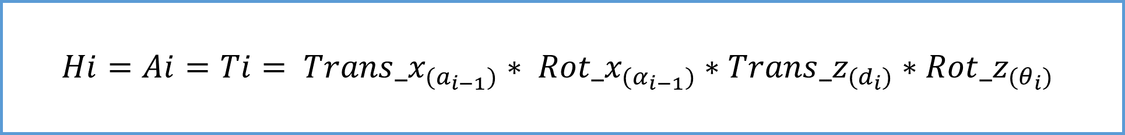
II. Forward kinematics
Denavit–Hartenberg convention
Homogenous Transformation matrices
$$Hi=Ai=Ti= {Trans_x}_{{(a}_{i−1})}∗ {Rot_x}_{{(α}_{i−1})}∗{Trans_z}_{(d_{i})}∗{Rot_z}_{(θ_{i})}$$
4
PHLOUCH Sokchea e20201275

Slide 7
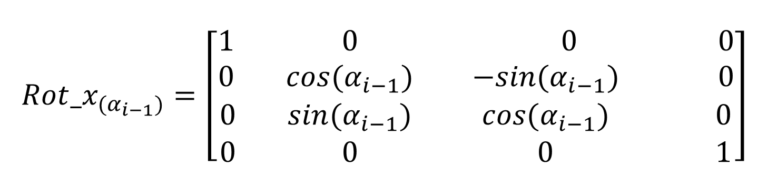
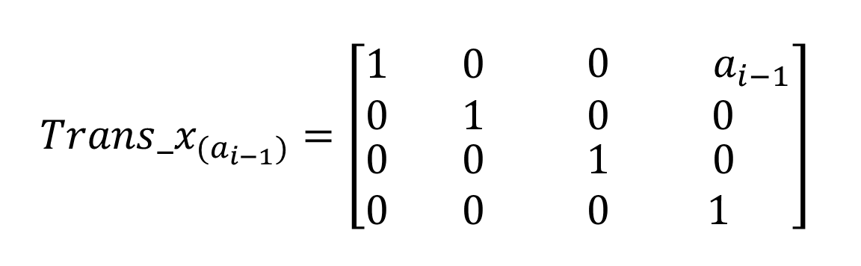
II.1. Rotation & Translation by x_axis
$${Trans_x}_{{(a}_{i−1})}=\left[\begin{matrix}\begin{matrix}1 & 0 \\ 0 & 1\end{matrix} & \begin{matrix}0 & { a}_{i−1} \\ 0 & 0\end{matrix} \\ \begin{matrix}0 & 0 \\ 0 & 0\end{matrix} & \begin{matrix}1 & 0 \\ 0 & 1\end{matrix}\end{matrix}\right]$$
$${Rot_x}_{{(α}_{i−1})}=\left[\begin{matrix}\begin{matrix}1 & 0 \\ 0 & cos{(α}_{i−1})\end{matrix} & \begin{matrix}0 & 0 \\ { −sin(α}_{i−1}) & 0\end{matrix} \\ \begin{matrix}0 & {sin(α}_{i−1}) \\ 0 & 0\end{matrix} & \begin{matrix}{cos(α}_{i−1}) & 0 \\ 0 & 1\end{matrix}\end{matrix}\right]$$
5
PHLOUCH Sokchea e20201275

Slide 8
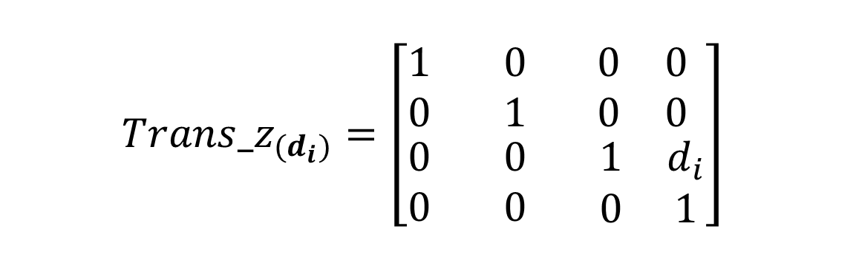
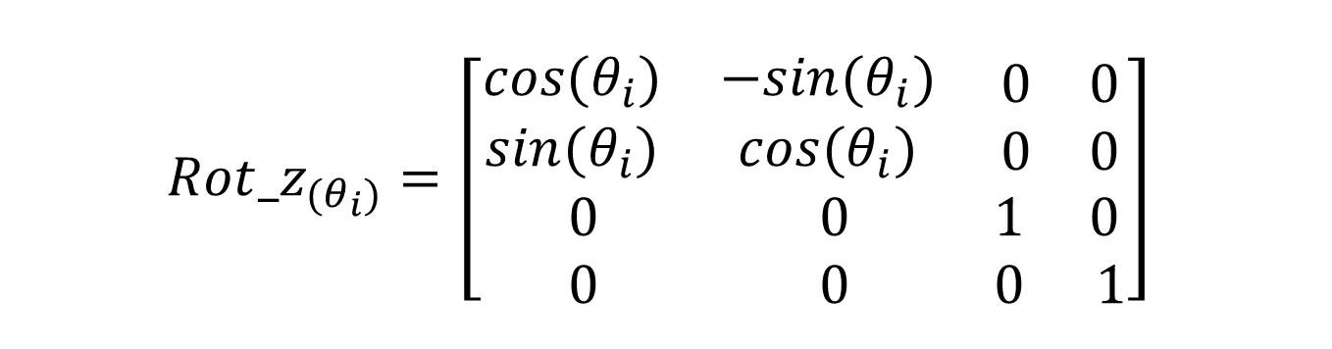
II.2. Rotation & Translation by z_axis
$${Trans_z}_{(d_{i})}=\left[\begin{matrix}\begin{matrix}1 & 0 \\ 0 & 1\end{matrix} & \begin{matrix}0 & 0 \\ 0 & 0\end{matrix} \\ \begin{matrix}0 & 0 \\ 0 & 0\end{matrix} & \begin{matrix}1 & d_{i} \\ 0 & 1\end{matrix}\end{matrix}\right]$$
$${Rot_z}_{(θ_{i})}=\left[\begin{matrix}\begin{matrix}cos(θ_{i}) & −sin(θ_{i}) \\ sin(θ_{i}) & cos(θ_{i})\end{matrix} & \begin{matrix}0 & 0 \\ 0 & 0\end{matrix} \\ \begin{matrix}0 & 0 \\ 0 & 0\end{matrix} & \begin{matrix}1 & 0 \\ 0 & 1\end{matrix}\end{matrix}\right]$$
6
PHLOUCH Sokchea e20201275

Slide 9
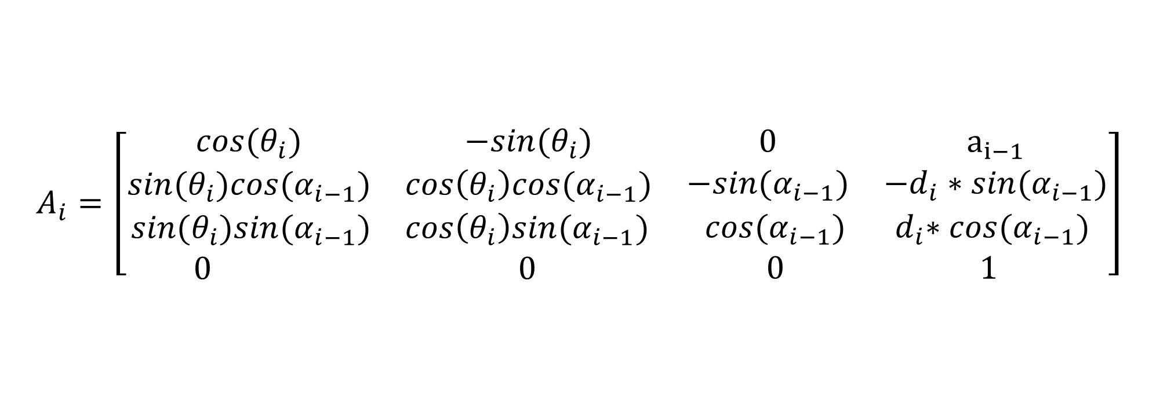
II.3. Homogenous Transformation matrices
Homogenous Transformation matrices
$$A_{i}=\left[\begin{matrix}\begin{matrix}cos(θ_{i}) & −sin(θ_{i}) \\ sin(θ_{i}){cos(α}_{i−1}) & cos\left(θ_{i}\right)cos{(α}_{i−1})\end{matrix} & \begin{matrix}0 & a_{i−1} \\ {−sin(α}_{i−1}) & −d_{i}∗sin{(α}_{i−1})\end{matrix} \\ \begin{matrix}sin(θ_{i}){sin(α}_{i−1}) & cos\left(θ_{i}\right)sin{(α}_{i−1}) \\ 0 & 0\end{matrix} & \begin{matrix}{cos(α}_{i−1}) & { d}_{i}∗{cos(α}_{i−1}) \\ 0 & 1\end{matrix}\end{matrix}\right]$$
Rotation 3*3
Translation 3*1
7
PHLOUCH Sokchea e20201275

Slide 10
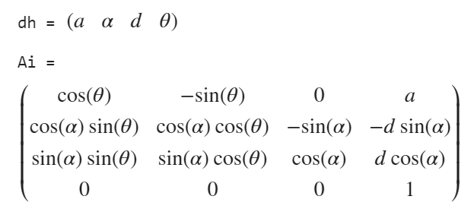
II.3. Homogenous Transformation matrices
8
PHLOUCH Sokchea e20201275

Slide 11
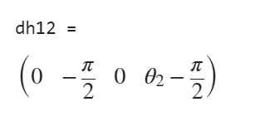

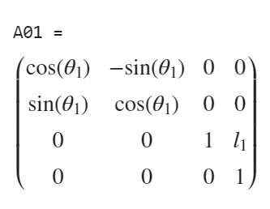
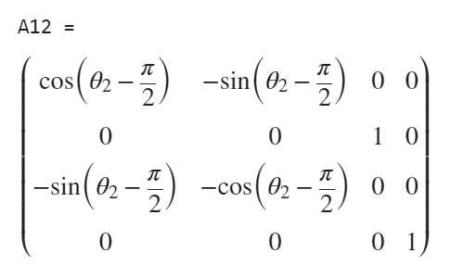
II.3. Homogenous Transformation matrices at link 01 & 12
9
PHLOUCH Sokchea e20201275

Slide 12

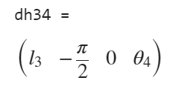
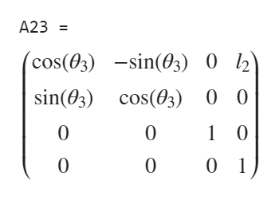
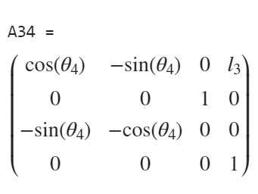
II.3. Homogenous Transformation matrices at link 23 & 34
10
PHLOUCH Sokchea e20201275

Slide 13

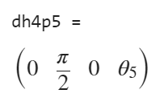
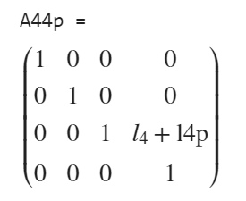
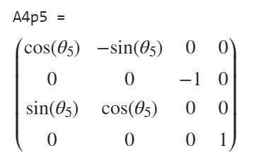
II.3. Homogenous Transformation matrices at link 44p & 4p5
11
PHLOUCH Sokchea e20201275

Slide 14
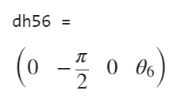

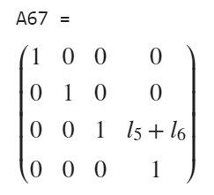
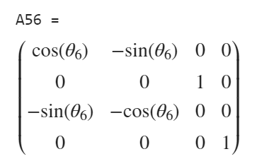
II.3. Homogenous Transformation matrices at link 56 & 67
12
PHLOUCH Sokchea e20201275

Slide 15
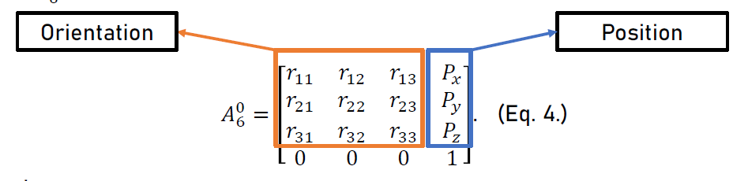
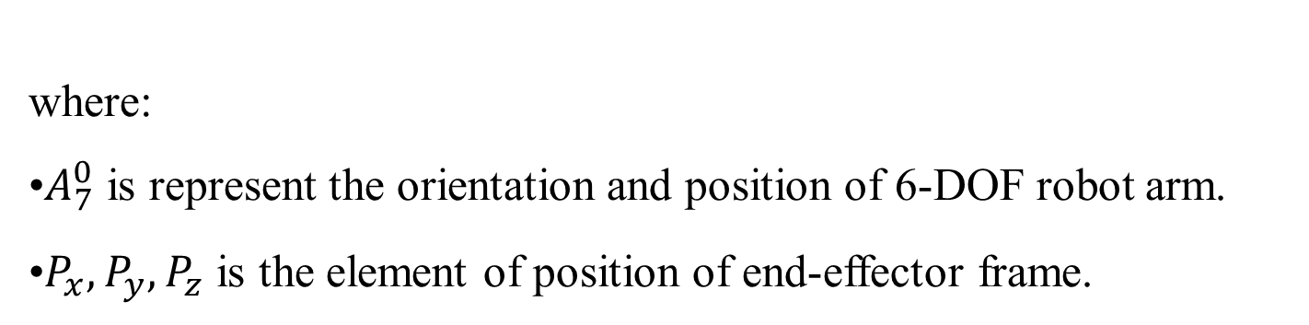
II.3. Homogenous Transformation matrices all links
where:
•$A_{7}^{0}$ is represent the orientation and position of 6-DOF robot arm.
•$P_{x},P_{y},P_{z}$ is the element of position of end-effector frame.
13
PHLOUCH Sokchea e20201275

Slide 16
Inverse
Kinematics
PHLOUCH Sokchea e20201275

Slide 17

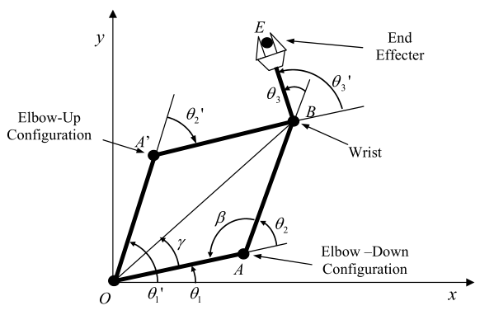

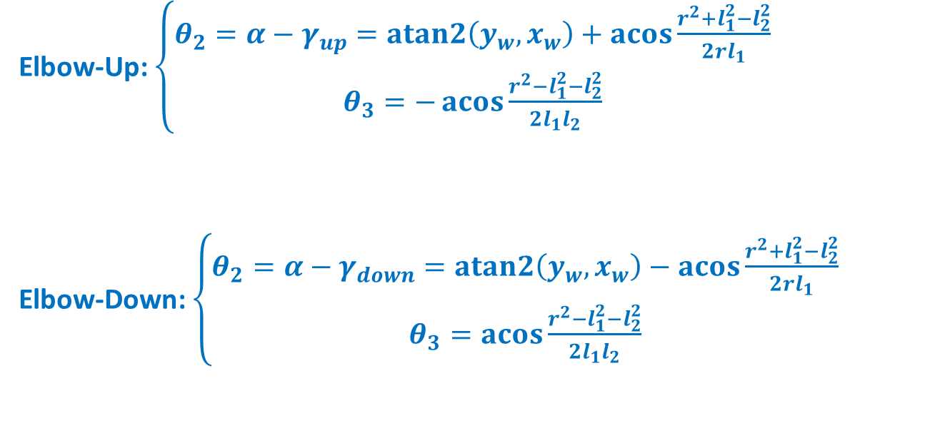






Two link planar
$$θ_{3}^{′}$$
$$W$$
Elbow-Up: $\left\{\begin{matrix}θ_{2}=α−γ_{up}=atan2\left(y_{w},x_{w}\right)+\operatorname{acos}{\frac{r^{2}+l_{1}^{2}−l_{2}^{2}}{2rl_{1}}} \\ θ_{3}=−\operatorname{acos}{\frac{r^{2}−l_{1}^{2}−l_{2}^{2}}{2l_{1}l_{2}}}\end{matrix}\right.$
Elbow-Down: $\left\{\begin{matrix}θ_{2}=α−γ_{down}=atan2\left(y_{w},x_{w}\right)−\operatorname{acos}{\frac{r^{2}+l_{1}^{2}−l_{2}^{2}}{2rl_{1}}} \\ θ_{3}=\operatorname{acos}{\frac{r^{2}−l_{1}^{2}−l_{2}^{2}}{2l_{1}l_{2}}}\end{matrix}\right.$
$$θ_{3}$$
$$l_{1}$$
$$θ_{2}^{′}$$
$$θ_{2}$$
Where $r=\sqrt{x_{w}^{2}+y_{w}^{2}}$
14
PHLOUCH Sokchea e20201275

Slide 18
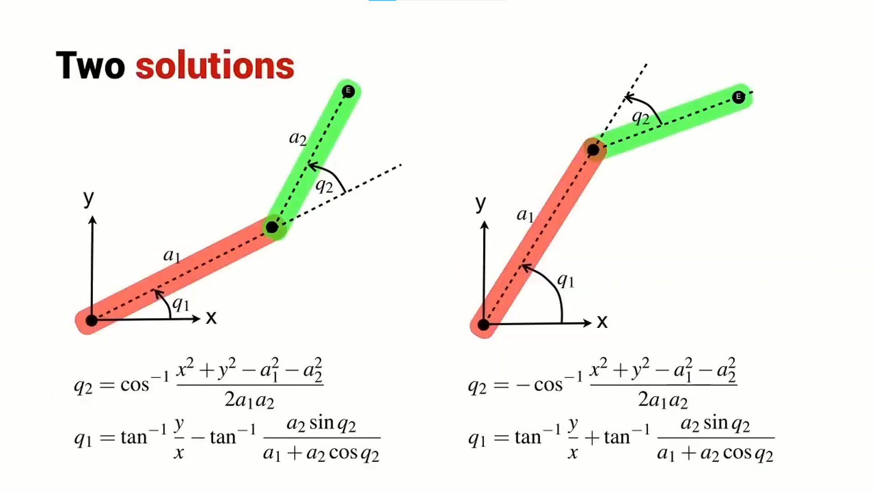
III. Inverse kinematics
Two link planar
15
PHLOUCH Sokchea e20201275

Slide 19











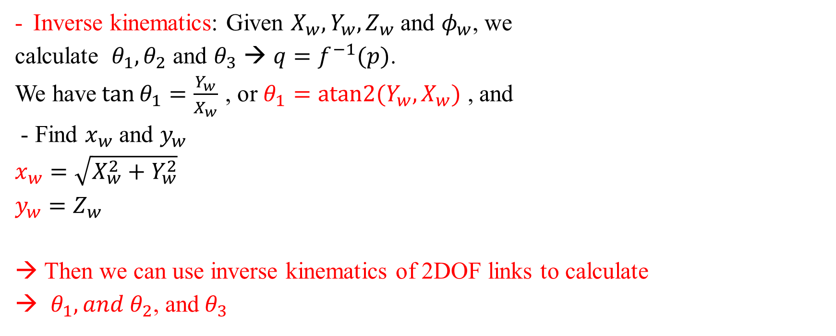






III. Inverse kinematics
4 links in space
$$Z$$
$$y$$
Inverse kinematics: Given $X_{w}, Y_{w}, Z_{w}$ and $φ_{w}$, we
calculate ${ θ}_{1}, θ_{2}$ and $θ_{3}$ → $q=f^{−1}(p)$.
We have$\tan{θ_{1}}=\frac{Y_{w}}{X_{w}}$ , or $θ_{1}=atan2{(Y_{w},X_{w})}$ , and
- Find $x_{w}$ and $y_{w}$
$x_{w}=\sqrt{X_{w}^{2}+Y_{w}^{2}}$
$y_{w}=Z_{w}$
Then we can use inverse kinematics of 2DOF links to calculate
$θ_{1}, and θ_{2}$, and$θ_{3}$
$$W$$
$$Y$$
$$θ_{3}$$
$$l_{3}$$
$$A$$
$$l_{2}$$
$$l_{1}$$
$$Y_{w}$$
$$θ_{2}$$
$$x$$
$$θ_{1}$$
$$x_{w}$$
$$X_{w}$$
$$X_{e}$$
$$X$$
16
PHLOUCH Sokchea e20201275

Slide 20


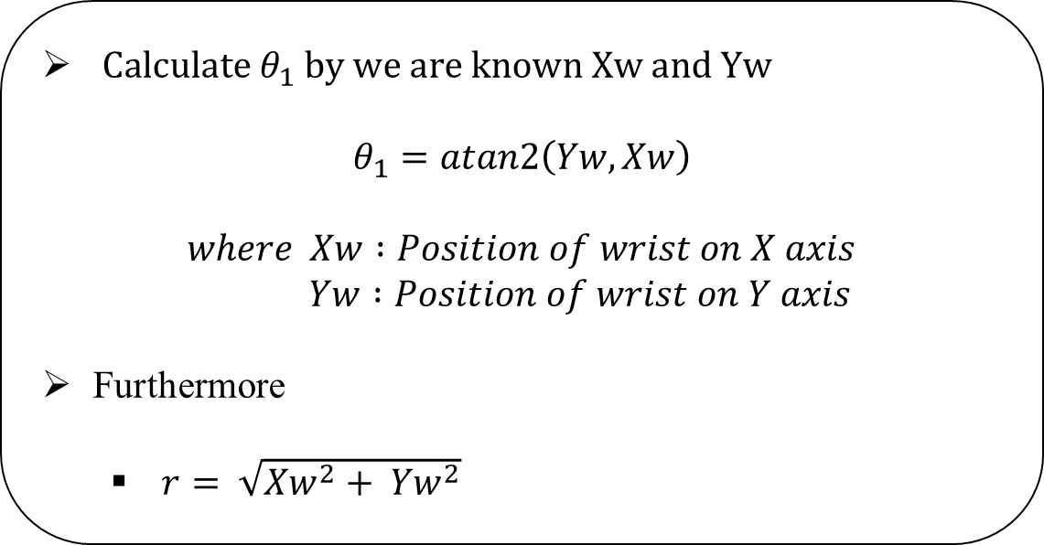
Applying geometric approach
Y
$Calculate θ_{1} by we are known Xw and Yw$
$$θ_{1}=atan2\left(Yw, Xw\right)$$
$$where Xw :Position of wrist on X axis$$
$$Yw :Position of wrist on Y axis$$
Furthermore
$r= \sqrt{{Xw}^{2}+ {Yw}^{2}}$
w
Yw
$$θ_{1}$$
X
Xw
Top view base to wrist
17
PHLOUCH Sokchea e20201275

Slide 21






We known
$h=Zw −l1$
$s= \sqrt{h^{2}+ r^{2}}$
$K= \sqrt{{l_{3}}^{2}+({l_{4}}^{2}+l_{4p}^{2}})$
Cosine law
$$θ_{2}=\frac{π}{2} − β − α$$
$$where$$
$α=atan\left(\frac{h}{r}\right)$
$β=acos\left(\frac{l_{2}^{2}+s^{2}−K^{2}}{2l_{2}s}\right)$
Z
$$θ_{3}$$
$$l_{3}$$
$$l_{4}+l4p$$
$$l_{2}$$
K
$$θ_{2}$$
h
X
Front view base to wrist
18
PHLOUCH Sokchea e20201275

Slide 22

We known
$h=Zw −l1$
$s= \sqrt{h^{2}+ r^{2}}$
$K= \sqrt{{l_{3}}^{2}+({l_{4}}^{2}+l_{4p}^{2}})$
Cosine law
$$θ_{3}=π − φ − γ$$
$$where$$
$φ=atan\left(\frac{l_{4 }+ l_{4p}}{l_{3}}\right)$
$γ=acos\left(\frac{l_{2}^{2} + K^{2} − s^{2}}{2l_{2}K}\right)$
Z
$$θ_{3}$$
$$l_{3}$$
$$l_{4}+l4p$$
$$l_{2}$$
K
$$θ_{2}$$
h
X
Front view base to wrist
19
PHLOUCH Sokchea e20201275

Slide 23
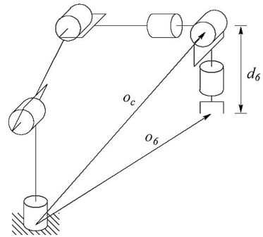
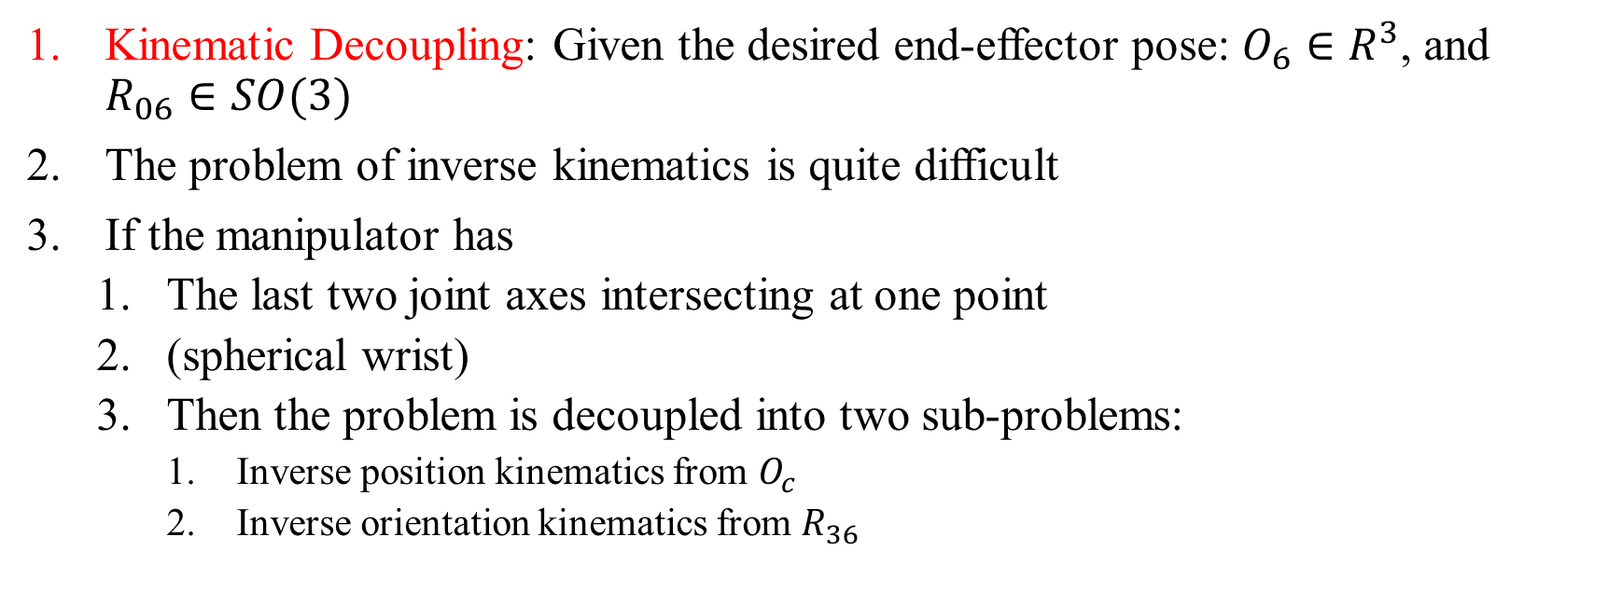
Kinematic Decoupling
Kinematic Decoupling: Given the desired end-effector pose: $O_{6}∈R^{3}$, and $R_{06}∈SO(3)$
The problem of inverse kinematics is quite difficult
If the manipulator has
The last two joint axes intersecting at one point
(spherical wrist)
Then the problem is decoupled into two sub-problems:
Inverse position kinematics from $O_{c}$
Inverse orientation kinematics from $R_{36}$
20
PHLOUCH Sokchea e20201275

Slide 24
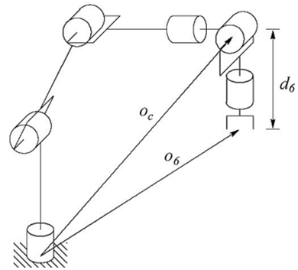
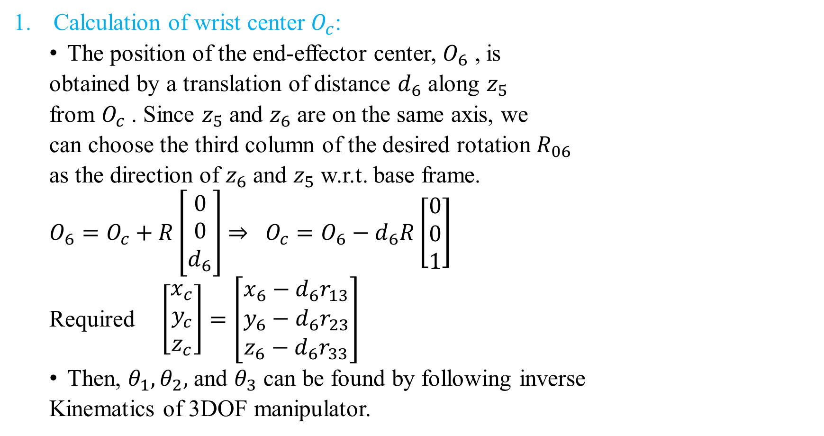
Calculation of wrist center $O_{c}$:
The position of the end-effector center, $O_{6}$ , is
obtained by a translation of distance $d_{6}$ along $z_{5}$
from $O_{c}$ . Since $z_{5}$ and $z_{6}$ are on the same axis, we
can choose the third column of the desired rotation $R_{06}$
as the direction of $z_{6}$ and $z_{5}$ w.r.t. base frame.
$O_{6}=O_{c}+R\left[\begin{aligned}0 \\ 0 \\ d_{6}\end{aligned}\right]$ $⇒ O_{c}=O_{6}−d_{6}R\left[\begin{aligned}0 \\ 0 \\ 1\end{aligned}\right]$
Required $\left[\begin{aligned}x_{c} \\ y_{c} \\ z_{c}\end{aligned}\right]=\left[\begin{aligned}x_{6}−d_{6}r_{13} \\ y_{6}−d_{6}r_{23} \\ z_{6}−d_{6}r_{33}\end{aligned}\right]$
Then, $θ_{1},θ_{2},$ and $θ_{3}$ can be found by following inverse
Kinematics of 3DOF manipulator.
21
PHLOUCH Sokchea e20201275

Slide 25
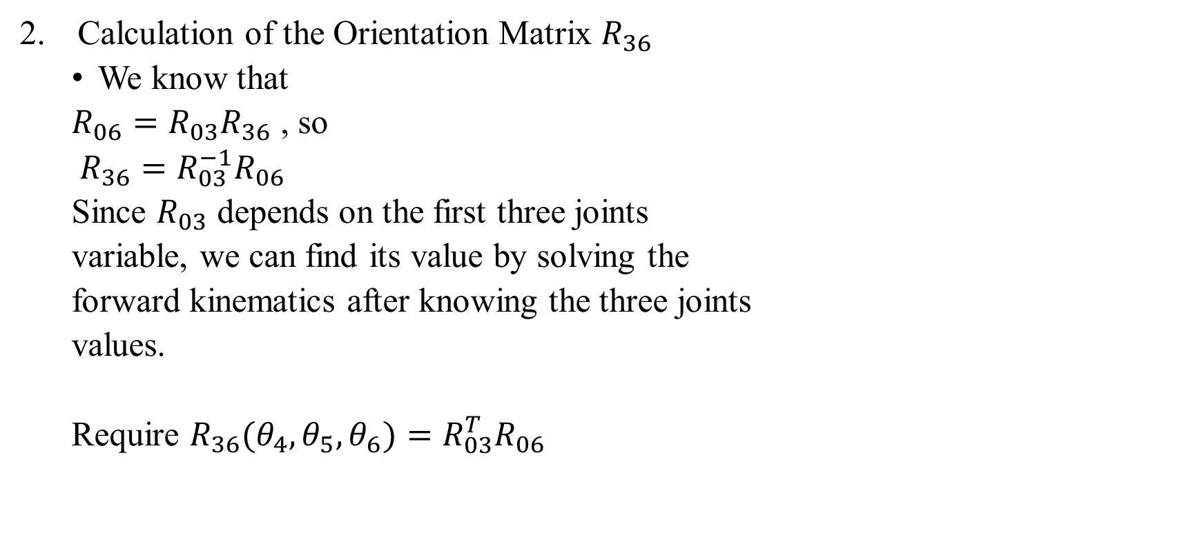
Calculation of the Orientation Matrix $R_{36}$
We know that
$R_{06}=R_{03}R_{36}$ , so
$R_{36}=R_{03}^{−1}R_{06}$
Since $R_{03}$ depends on the first three joints
variable, we can find its value by solving the
forward kinematics after knowing the three joints
values.
Require $R_{36}(θ_{4},θ_{5},θ_{6})=R_{03}^{T}R_{06}$
22
PHLOUCH Sokchea e20201275

Slide 26
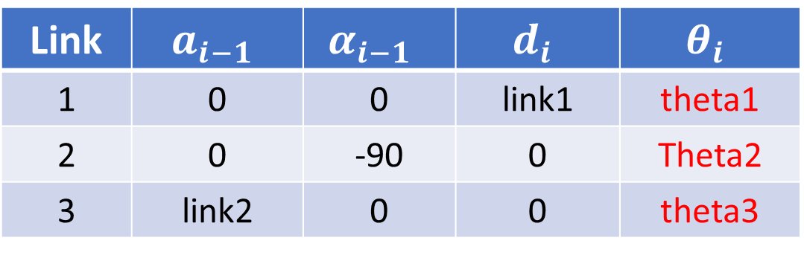

$R_{03}=$Rotation$(T_{03})$ from DH parameters
Link | $$a_{i−1}$$ | $$α_{i−1}$$ | $$d_{i}$$ | $$θ_{i}$$
1 | 0 | 0 | link1 | theta1
2 | 0 | -90 | 0 | Theta2
3 | link2 | 0 | 0 | theta3
23
PHLOUCH Sokchea e20201275

Slide 27
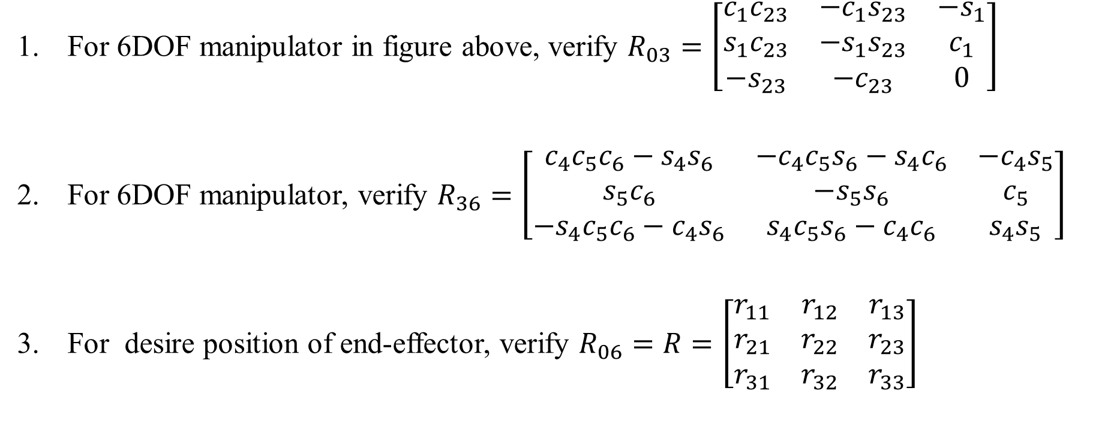
For 6DOF manipulator in figure above, verify $R_{03}=\left[\begin{matrix}c_{1}c_{23} & −c_{1}s_{23} & {−s}_{1} \\ s_{1}c_{23} & −s_{1}s_{23} & c_{1} \\ {−s}_{23} & {−c}_{23} & 0\end{matrix}\right]$
For 6DOF manipulator, verify $R_{36}=\left[\begin{matrix}c_{4}c_{5}c_{6}−s_{4}s_{6} & −c_{4}c_{5}s_{6}−s_{4}c_{6} & −c_{4}s_{5} \\ s_{5}c_{6} & −s_{5}s_{6} & c_{5} \\ −s_{4}c_{5}c_{6}−c_{4}s_{6} & s_{4}c_{5}s_{6}−c_{4}c_{6} & s_{4}s_{5}\end{matrix}\right]$
For desire position of end-effector, verify $R_{06}=R=\left[\begin{matrix}r_{11} & r_{12} & r_{13} \\ r_{21} & r_{22} & r_{23} \\ r_{31} & r_{32} & r_{33}\end{matrix}\right]$
24
PHLOUCH Sokchea e20201275

Slide 28
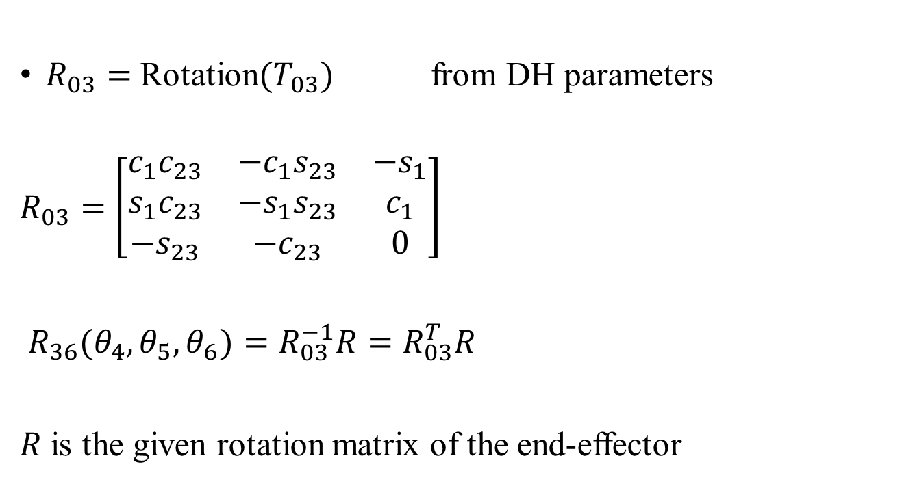
$R_{03}=$ Rotation$(T_{03})$ from DH parameters
$R_{03}=$ $\left[\begin{matrix}c_{1}c_{23} & −c_{1}s_{23} & {−s}_{1} \\ s_{1}c_{23} & −s_{1}s_{23} & c_{1} \\ {−s}_{23} & {−c}_{23} & 0\end{matrix}\right]$
$R_{36}(θ_{4},θ_{5},θ_{6})=R_{03}^{−1}R=R_{03}^{T}R$
$R$ is the given rotation matrix of the end-effector
25
PHLOUCH Sokchea e20201275

Slide 29
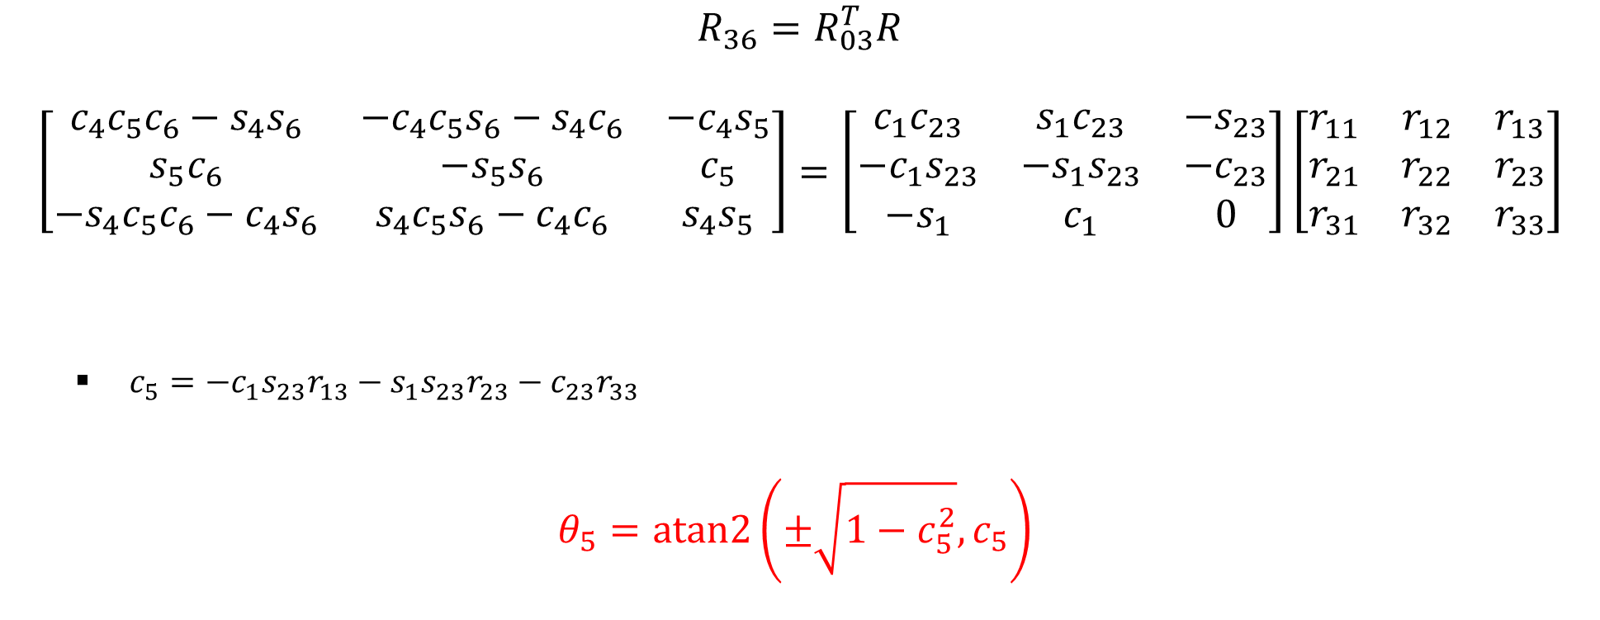
$$R_{36}=R_{03}^{T}R$$
$$\left[\begin{matrix}c_{4}c_{5}c_{6}−s_{4}s_{6} & −c_{4}c_{5}s_{6}−s_{4}c_{6} & −c_{4}s_{5} \\ s_{5}c_{6} & −s_{5}s_{6} & c_{5} \\ −s_{4}c_{5}c_{6}−c_{4}s_{6} & s_{4}c_{5}s_{6}−c_{4}c_{6} & s_{4}s_{5}\end{matrix}\right]=\left[\begin{matrix}c_{1}c_{23} & s_{1}c_{23} & {−s}_{23} \\ −c_{1}s_{23} & −s_{1}s_{23} & {−c}_{23} \\ −s_{1} & c_{1} & 0\end{matrix}\right]\left[\begin{matrix}r_{11} & r_{12} & r_{13} \\ r_{21} & r_{22} & r_{23} \\ r_{31} & r_{32} & r_{33}\end{matrix}\right]$$
$c_{5}=−c_{1}s_{23}r_{13}−s_{1}s_{23}r_{23}−c_{23}r_{33}$
$θ_{5}=atan2\left(±\sqrt{1−c_{5}^{2}}, c_{5}\right)$
26
PHLOUCH Sokchea e20201275

Slide 30
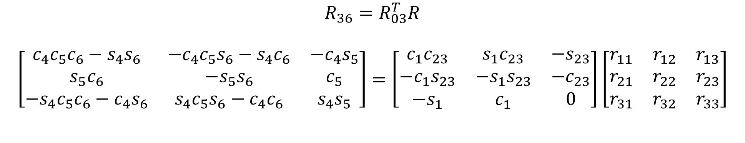
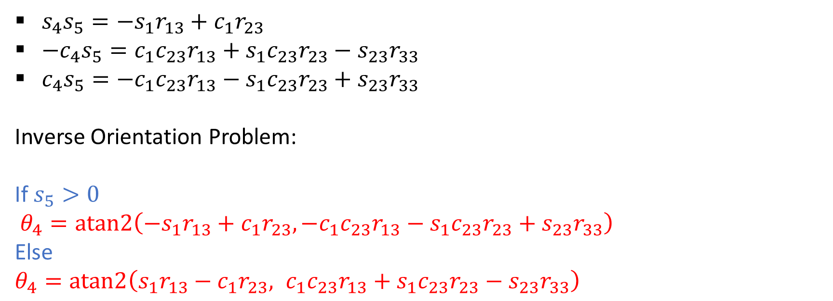
$$R_{36}=R_{03}^{T}R$$
$$\left[\begin{matrix}c_{4}c_{5}c_{6}−s_{4}s_{6} & −c_{4}c_{5}s_{6}−s_{4}c_{6} & −c_{4}s_{5} \\ s_{5}c_{6} & −s_{5}s_{6} & c_{5} \\ −s_{4}c_{5}c_{6}−c_{4}s_{6} & s_{4}c_{5}s_{6}−c_{4}c_{6} & s_{4}s_{5}\end{matrix}\right]=\left[\begin{matrix}c_{1}c_{23} & s_{1}c_{23} & {−s}_{23} \\ −c_{1}s_{23} & −s_{1}s_{23} & {−c}_{23} \\ −s_{1} & c_{1} & 0\end{matrix}\right]\left[\begin{matrix}r_{11} & r_{12} & r_{13} \\ r_{21} & r_{22} & r_{23} \\ r_{31} & r_{32} & r_{33}\end{matrix}\right]$$
$s_{4}s_{5}={−s}_{1}r_{13}+c_{1}r_{23}$
${{−c}_{4}s}_{5}=c_{1}c_{23}r_{13}+s_{1}c_{23}r_{23}−s_{23}r_{33}$
${c_{4}s}_{5}=−c_{1}c_{23}r_{13}−s_{1}c_{23}r_{23}+s_{23}r_{33}$
Inverse Orientation Problem:
If $s_{5}>0$
$θ_{4}=atan2\left({−s}_{1}r_{13}+c_{1}r_{23},−c_{1}c_{23}r_{13}−s_{1}c_{23}r_{23}+s_{23}r_{33}\right)$
Else
$θ_{4}=atan2\left(s_{1}r_{13}−c_{1}r_{23}, c_{1}c_{23}r_{13}+s_{1}c_{23}r_{23}−s_{23}r_{33}\right)$
27
PHLOUCH Sokchea e20201275

Slide 31
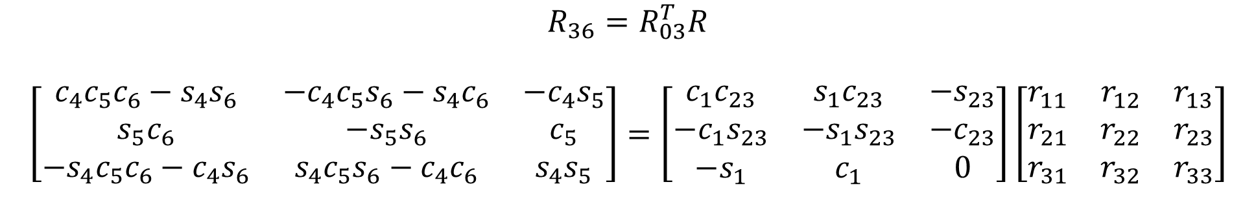
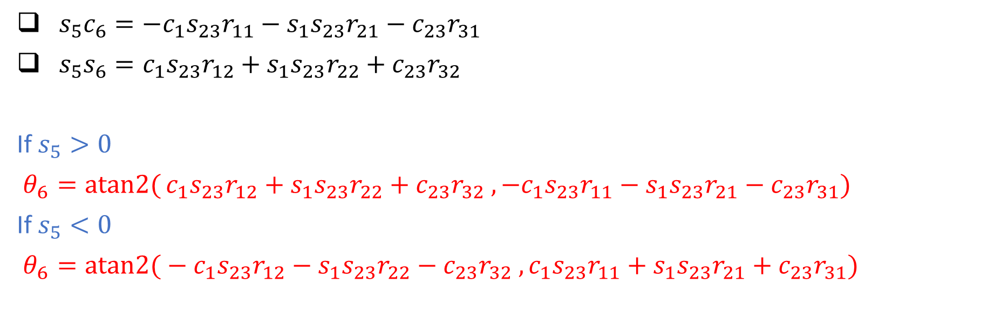
$$R_{36}=R_{03}^{T}R$$
$$\left[\begin{matrix}c_{4}c_{5}c_{6}−s_{4}s_{6} & −c_{4}c_{5}s_{6}−s_{4}c_{6} & −c_{4}s_{5} \\ s_{5}c_{6} & −s_{5}s_{6} & c_{5} \\ −s_{4}c_{5}c_{6}−c_{4}s_{6} & s_{4}c_{5}s_{6}−c_{4}c_{6} & s_{4}s_{5}\end{matrix}\right]=\left[\begin{matrix}c_{1}c_{23} & s_{1}c_{23} & {−s}_{23} \\ −c_{1}s_{23} & −s_{1}s_{23} & {−c}_{23} \\ −s_{1} & c_{1} & 0\end{matrix}\right]\left[\begin{matrix}r_{11} & r_{12} & r_{13} \\ r_{21} & r_{22} & r_{23} \\ r_{31} & r_{32} & r_{33}\end{matrix}\right]$$
$s_{5}c_{6}=−c_{1}s_{23}r_{11}−s_{1}s_{23}r_{21}−c_{23}r_{31}$
$s_{5}s_{6}=c_{1}s_{23}r_{12}+s_{1}s_{23}r_{22}+c_{23}r_{32}$
If $s_{5}>0$
$θ_{6}=atan2{(}c_{1}s_{23}r_{12}+s_{1}s_{23}r_{22}+c_{23}r_{32} ,−c_{1}s_{23}r_{11}−s_{1}s_{23}r_{21}−c_{23}r_{31})$
If $s_{5}<0$
$θ_{6}=atan2{(}−c_{1}s_{23}r_{12}−s_{1}s_{23}r_{22}−c_{23}r_{32} ,c_{1}s_{23}r_{11}+s_{1}s_{23}r_{21}+c_{23}r_{31})$
28
PHLOUCH Sokchea e20201275

Slide 32
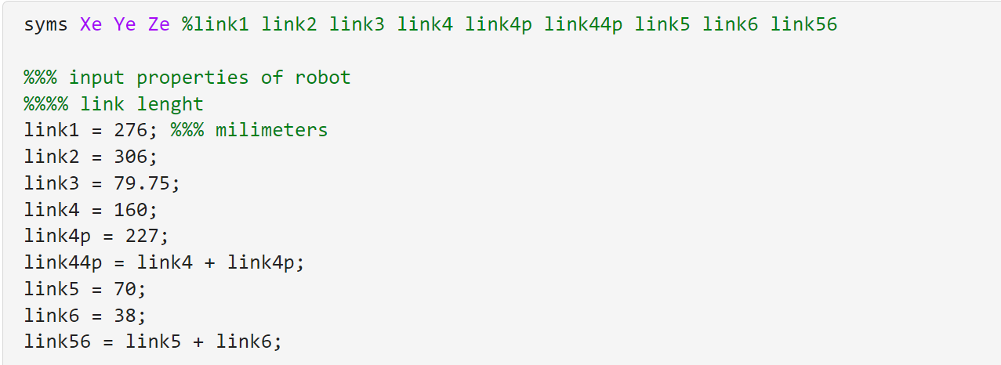
Matlab
29
PHLOUCH Sokchea e20201275

Slide 33
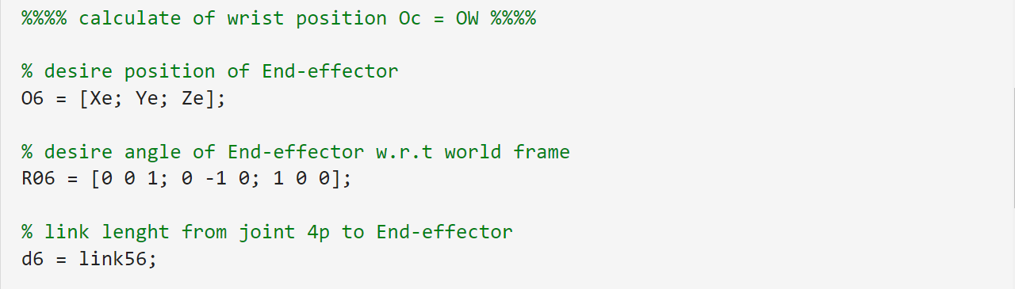
Matlab
30
PHLOUCH Sokchea e20201275

Slide 34
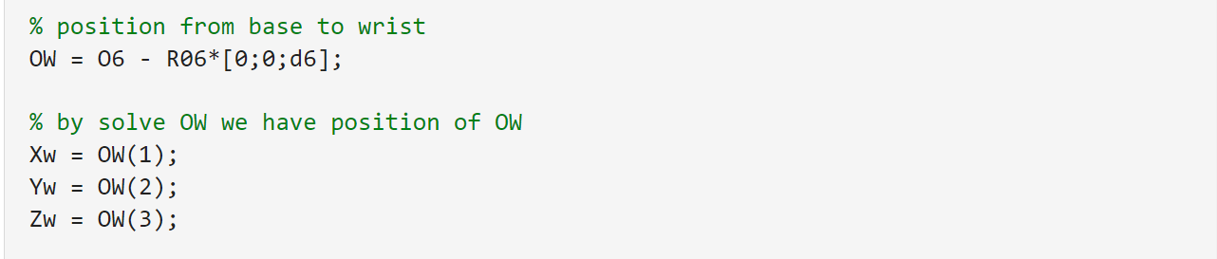
Matlab
31
PHLOUCH Sokchea e20201275

Slide 35
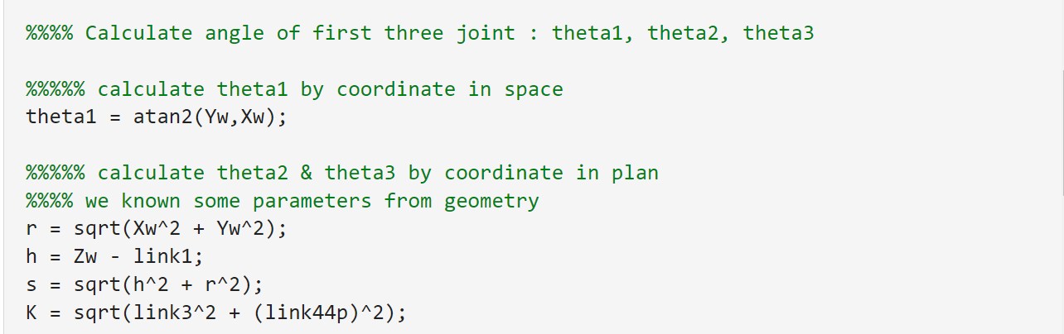
Matlab
32
PHLOUCH Sokchea e20201275

Slide 36
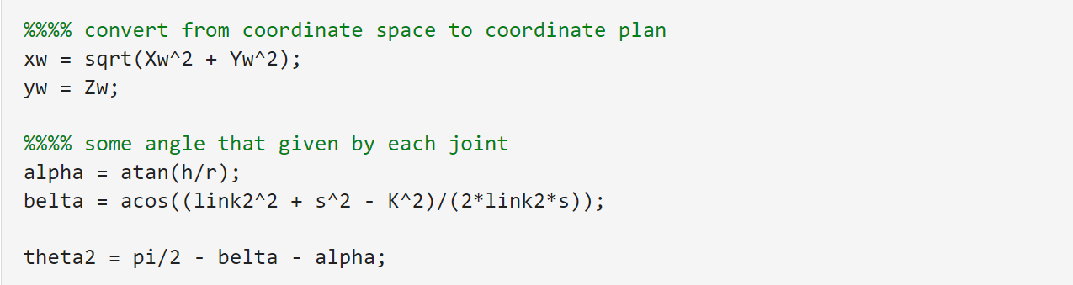
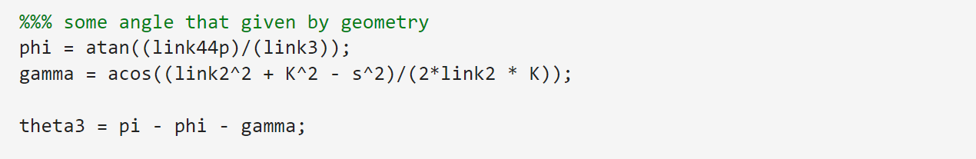
Matlab
33
PHLOUCH Sokchea e20201275

Slide 37

Matlab
34
PHLOUCH Sokchea e20201275

Slide 38

Matlab
35
PHLOUCH Sokchea e20201275

Slide 39

Matlab
36
PHLOUCH Sokchea e20201275

Slide 40

Matlab
37
PHLOUCH Sokchea e20201275

Slide 41

Matlab
38
PHLOUCH Sokchea e20201275

Slide 42

Matlab
39
PHLOUCH Sokchea e20201275

Slide 43
End
40
PHLOUCH Sokchea e20201275

Slide 44
Robot Model
1
PHLOUCH Sokchea e20201275

Slide 45
I. Robot Model
1
PHLOUCH Sokchea e20201275

Slide 46


Slide 47
l4
l4p
l5
l6
l3
l2
l1
1
PHLOUCH Sokchea e20201275

Slide 48
DH Convention
Link | Joint | a (i-1) | alpha (i-1) | d (i) | Theta (i)
0 – 1 | 1 | 0 | 0 | link1 | Theta1
1 – 2 | 2 | 0 | -90 | 0 | Theta2 - 90
2 – 3 | 3 | link2 | 0 | 0 | Theta3
3 – 4 | 4 | link3 | -90 | 0 | Theta4
4 – 4p | 4p | 0 | 0 | Link44p | 0
4p – 5 | 5 | 0 | 90 | 0 | Theta5
5 - 6 | 6 | 0 | -90 | 0 | Theta6
6 - 7 | 7 | 0 | 0 | link56 | 0
1
PHLOUCH Sokchea e20201275

Slide 49
l4
l4p
l5
l6
l3
l2
l1

Slide 50
Link 1 = 276mm
Link 5 = 70mm
Link 2 = 306mm
Link 6 = 38mm
Link 3 = 79.75mm
Link 44p = 160+227mm
Link 4 = 160mm
Link 56 = 70+38mm
Link 4p = 227mm

